Slide 1
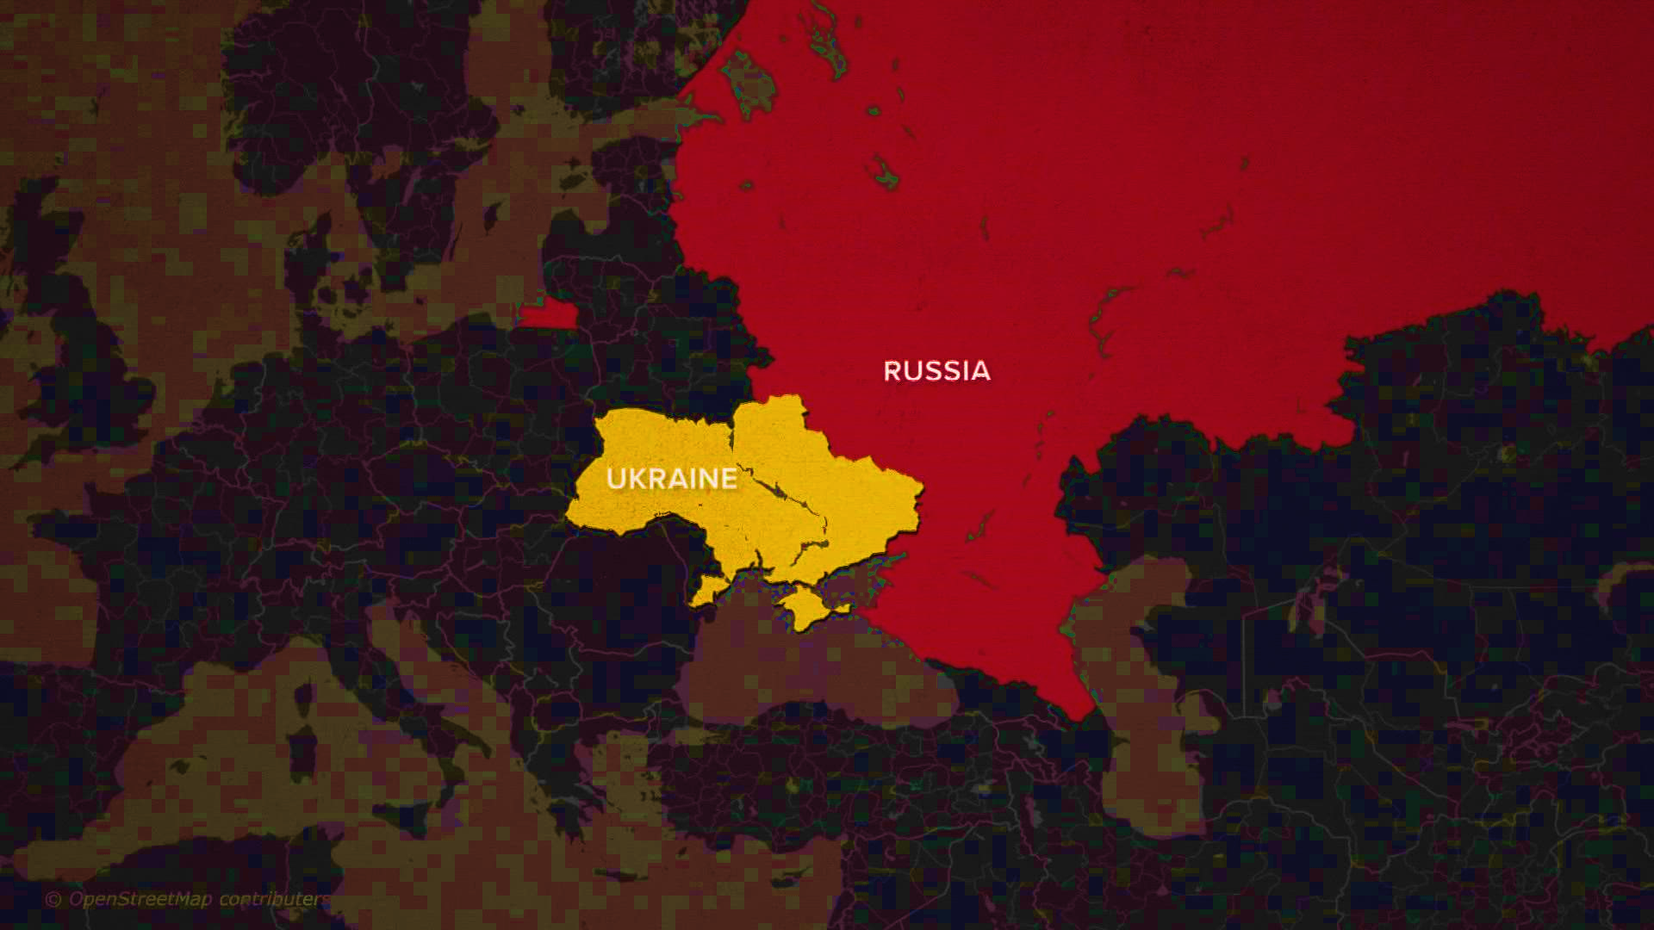
28x

Slide 2
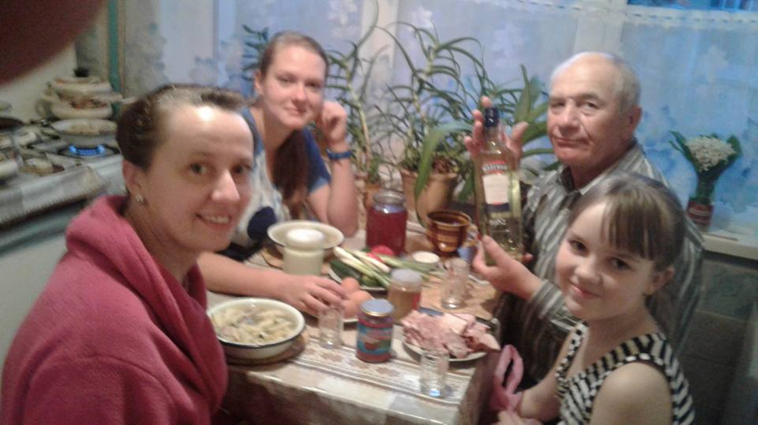
2017

Slide 3
The Red Zone

Slide 4
Every day noises
Late sirens
"I'll just live until I dont" + story

Slide 5
City destruction

Slide 6
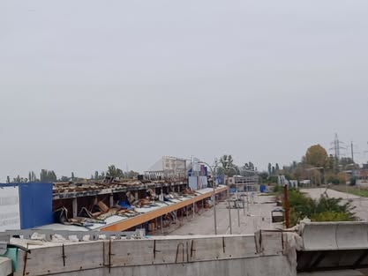

Slide 7
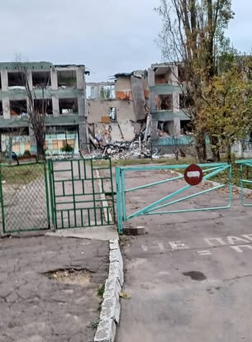

Slide 8
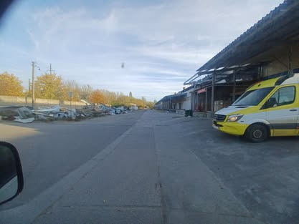

Slide 9
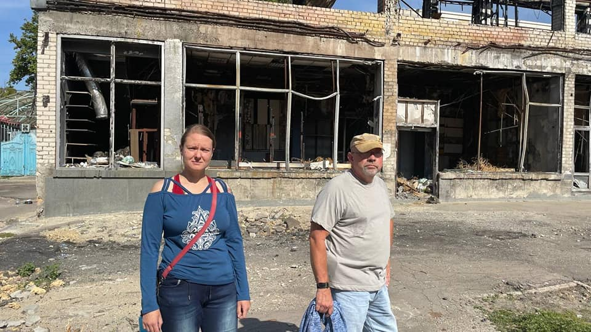

Slide 10
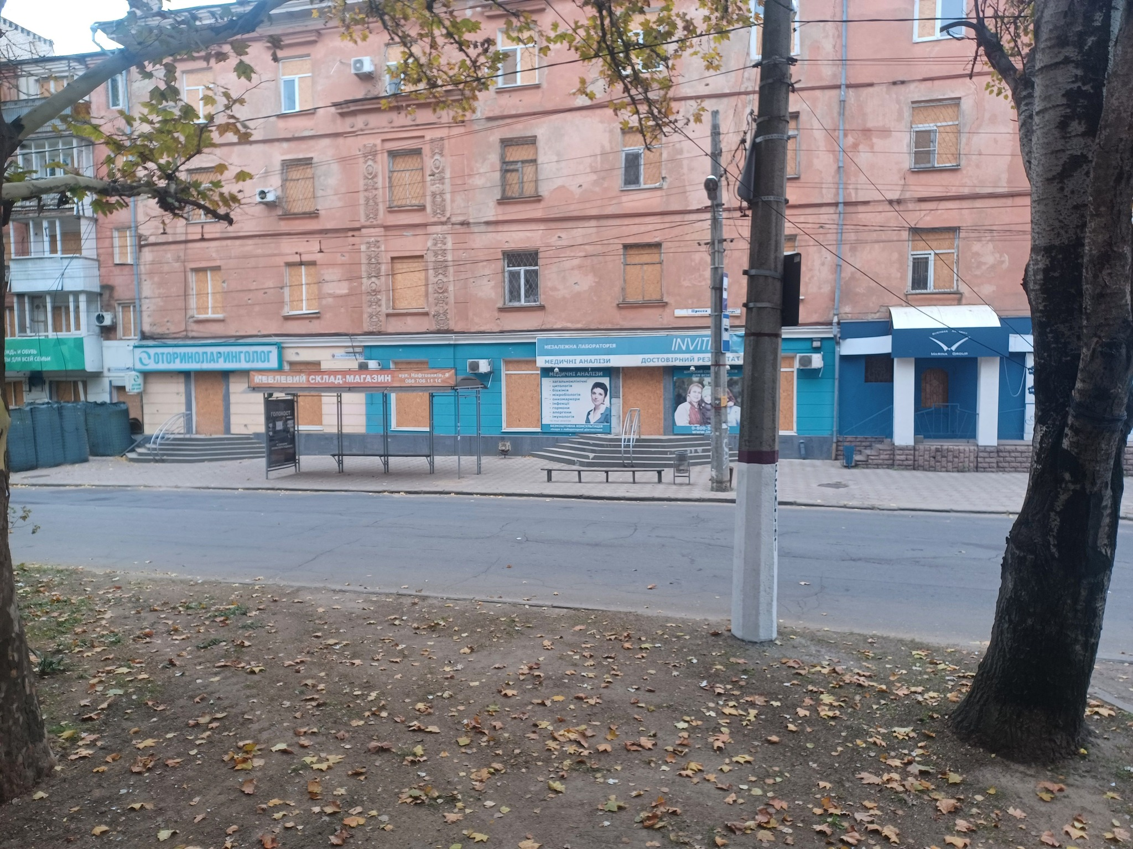

Slide 11
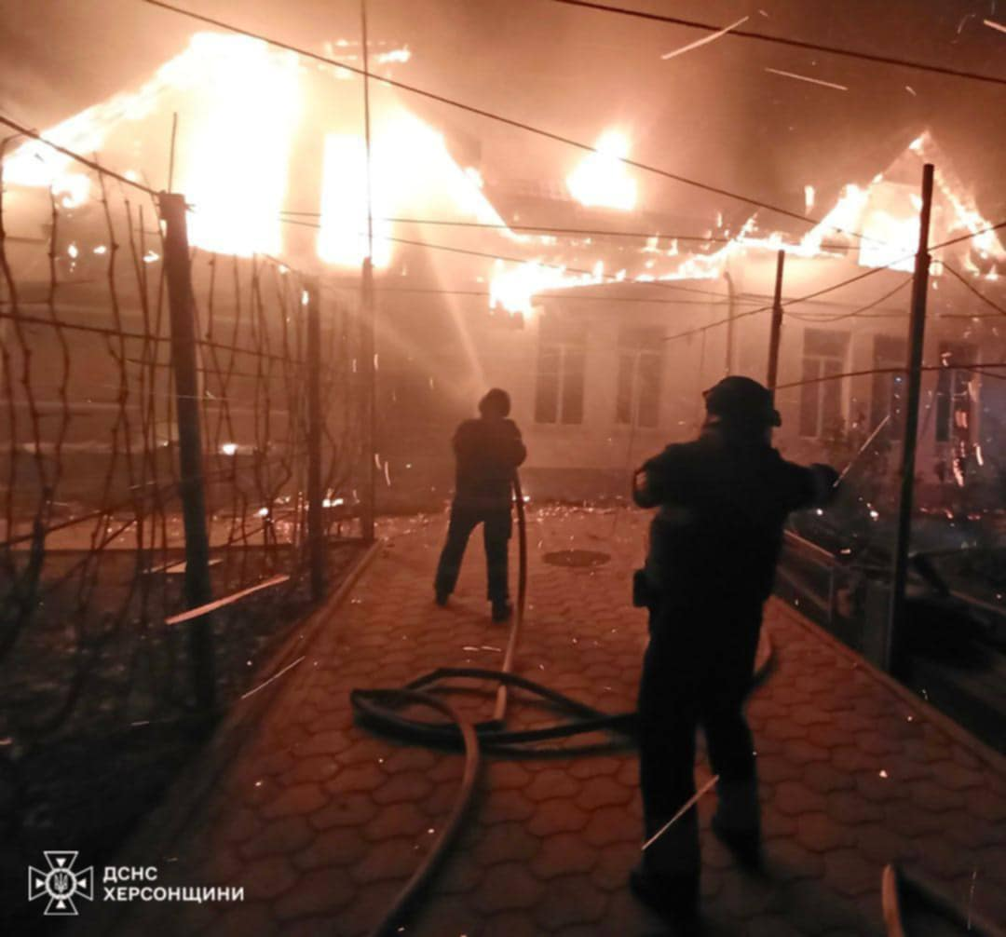

Slide 12
Water Dam explosion
https://youtu.be/q0yB3Ald-P8

Slide 13
Drones
Human Safari
Life continues – bus story

Slide 14
The volunteers

Slide 15
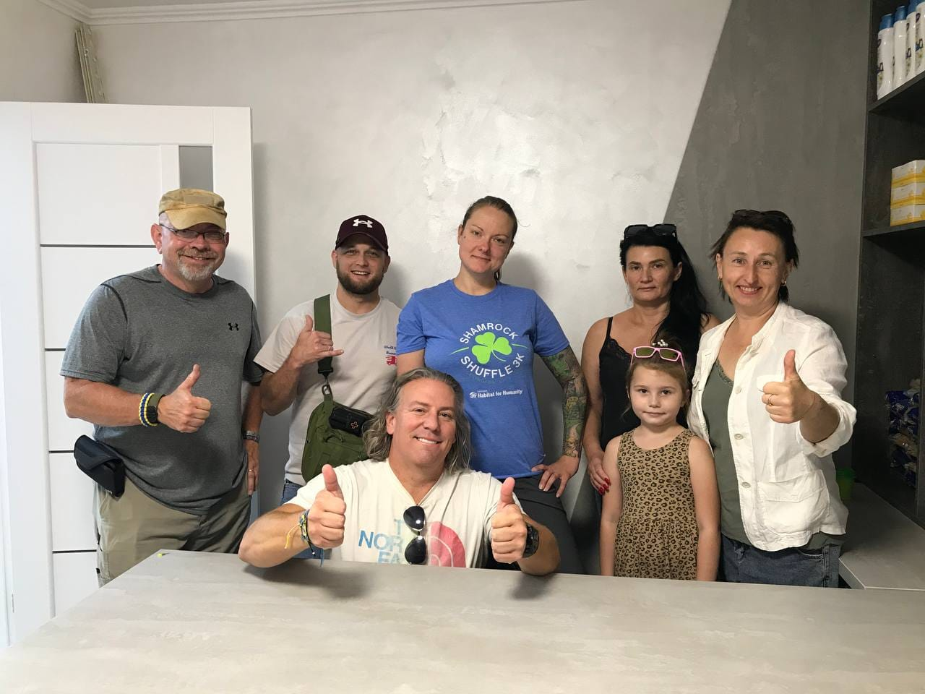

Slide 16
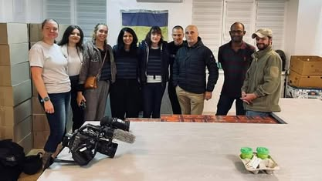
Russian drones hunt Ukraine civilians, evidence suggests | BBC News

Slide 17
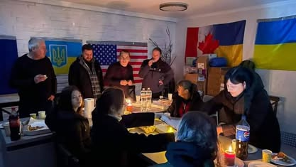

Slide 19
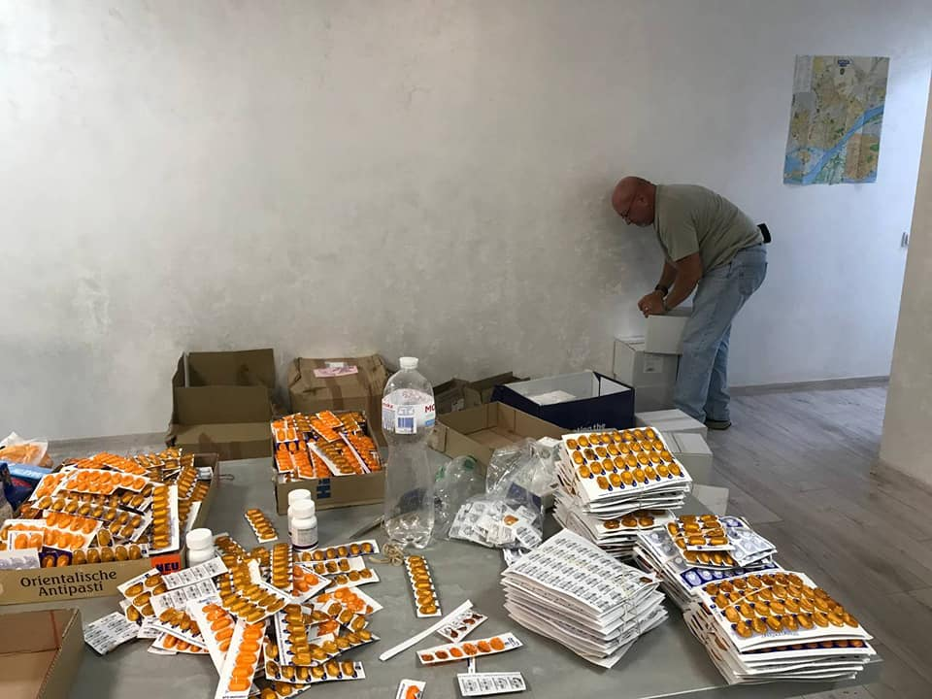

Slide 20
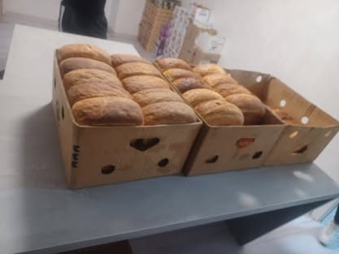

Slide 21
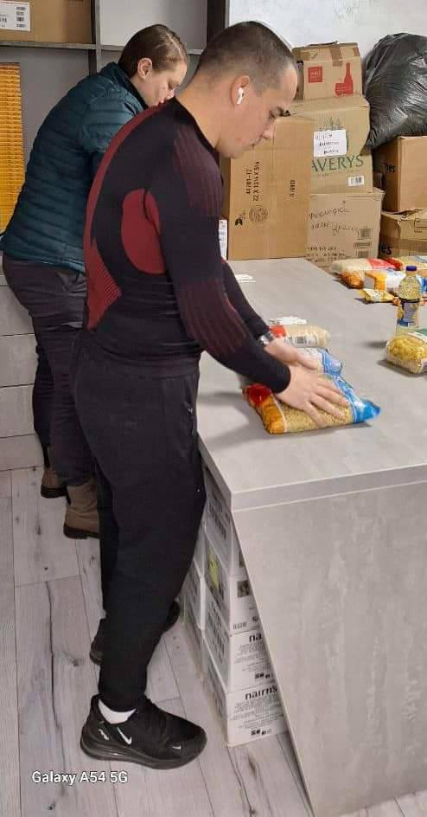

Slide 22
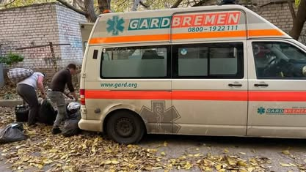

Slide 24
The “why”

Slide 25
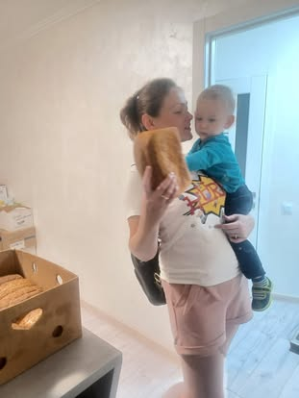

Slide 26
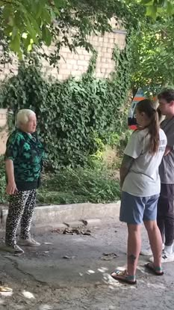
https://www.youtube.com/watch?v=oYKuNfwNbaU&pp=ygUUaHVtYW4gc2FmYXJpIGtoZXJzb24%3D

Slide 27
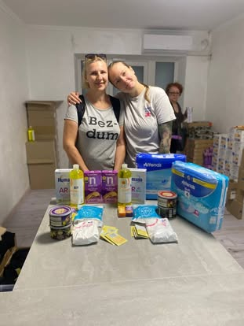

Slide 28
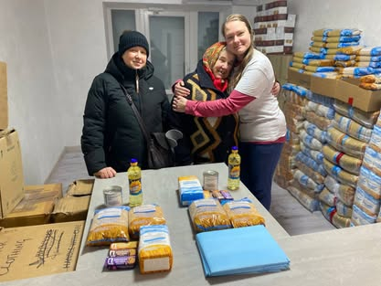

Slide 29
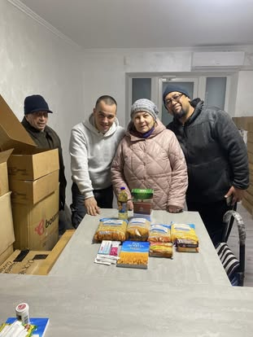

Slide 30
Ways to Help – organizations, individuals, self
Humanitarian aid
Food pantry
Hygiene
Elder care items
Medicine
Vouchers
Animals
Military
Vehicles
Technology
Medicines
First aid

Slide 31
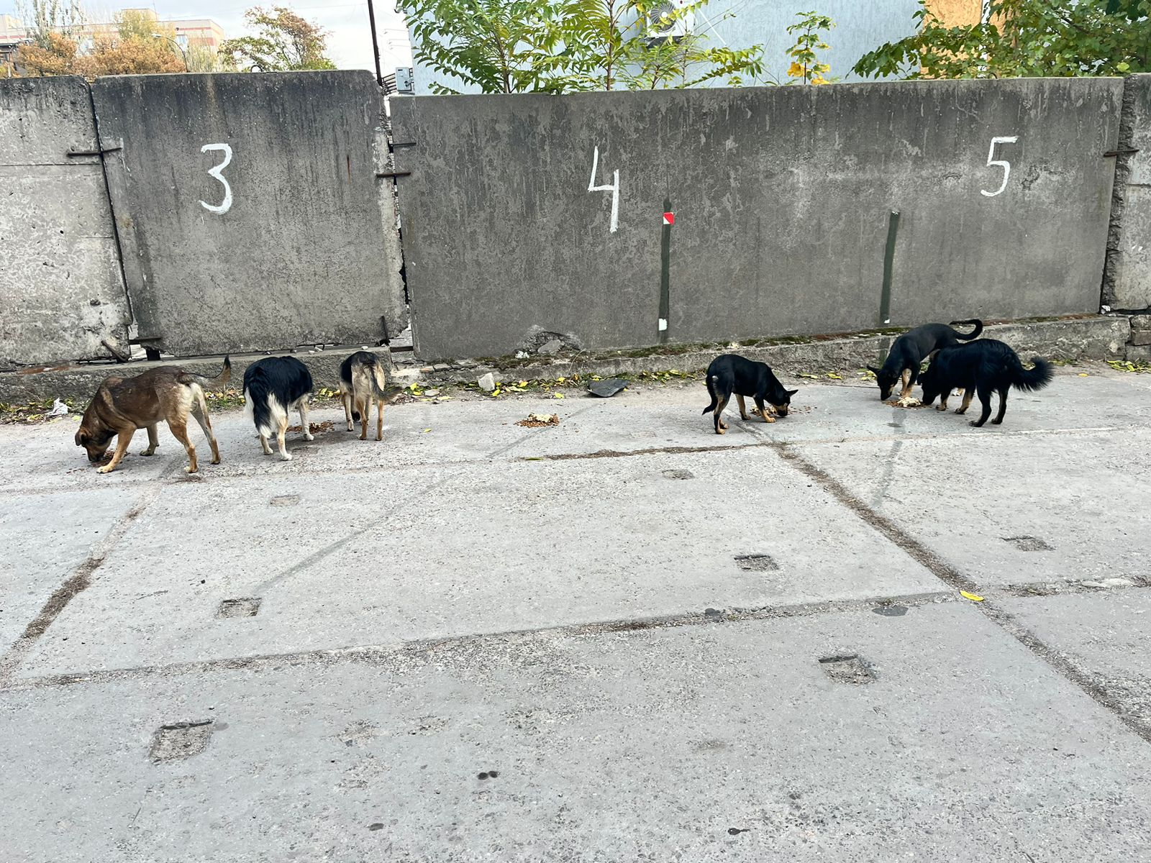

Slide 32
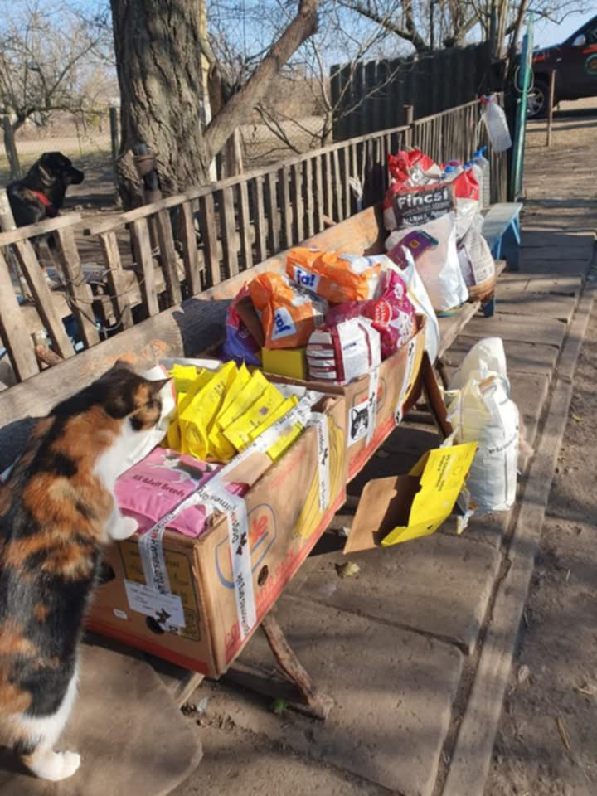
Lionel De Range, South Africa Warriors of Wildlife warriorsofwildlife.org/donations

Slide 33
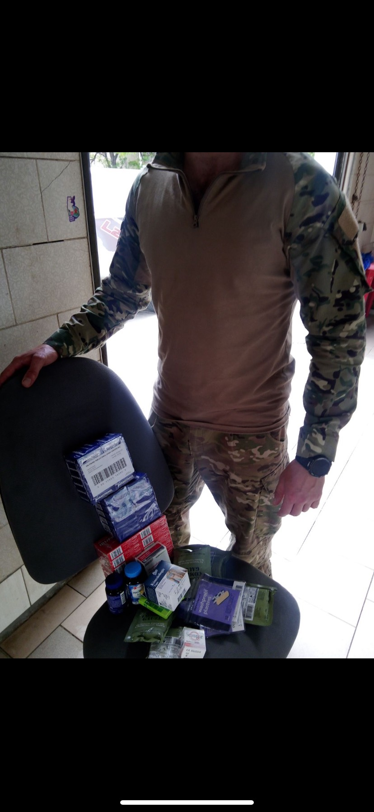
PayPal zragevskayainna19121981@gmail.com

Slide 35
Inna Malyuk fundraiser https://gofund.me/2d675931 Inna Malyuk PayPal mergiosha1@gmail.com

